Slide 1
VISUAL STUDIO IDE

Slide 2
Objectives
What is Visual Studio IDE
Creating a new project in VS IDE
Writing code using Text/Code Editor in VS IDE
Compiling (build/rebuild/clean) application and complete solution
Output, Error List, Solution Explorer, Server Explorer, Properties Window
Changing Settings in VS IDE
Adding multiple projects in the same solution
Removing existing project from a solution
Setting Start up project
Adding new item in an existing project
Adding Reference to libraries

Slide 3
Visual Studio IDE
Microsoft Visual Studio is an integrated development environment (IDE) from Microsoft.
It is used to develop console and graphical user interface applications along with Windows Forms or WPF applications, web sites, web applications, and web services in both native code together with managed code for all platforms supported by Microsoft Windows, Windows Mobile, Windows CE, .NET Framework, .NET Compact Framework and Microsoft Silverlight.
Visual Studio includes a code editor supporting IntelliSense as well as code refactoring.
The integrated debugger works both as a source-level debugger and a machine-level debugger. Other built-in tools include a forms designer for building GUI applications, web designer, class designer, and database schema designer.

Slide 4
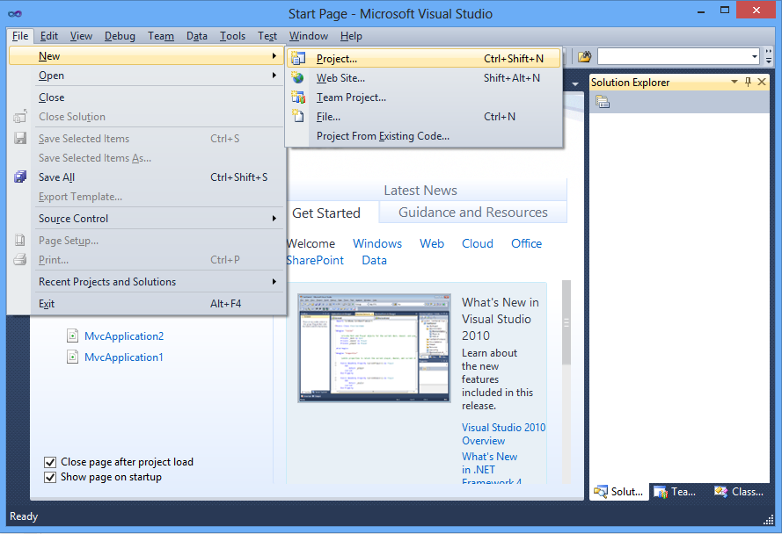
Creating Project in Visual Studio
Notes:
• On the File menu, click New and then click Project.
• This opens the New Project dialog box.

Slide 5
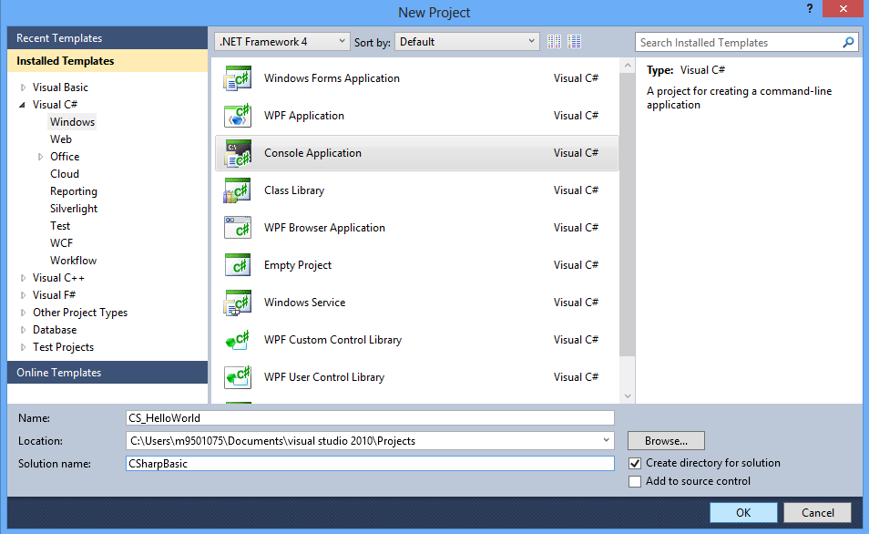
Choose a Proper Language and Project Template
Language
Type of Application/ project
Description of the selected project template
Project Template
Application/Project Name
Solution Name
Location
Notes:
New Project Dialog Box:
• In the left pane, select a language under Installed Templates, and then select a category of project types from the expanded list.
• If you have recently created a project of the same type, select Recent instead for faster navigation.
• Select one of the project Templates from the middle pane.
• A description of the selected template appears in the right pane.
• In the Name box, type a name for the new project.
• In the Location box, select a save location.
• If available, in the Solution list, specify whether to create a solution or add the project to the solution that is open in Solution Explorer.
• In the Solution name box, type a name for the solution.
• Visual Studio will use this name for the namespace of the finished project if applicable. By default, the solution name will match the project name.
• Make sure that the Create directory for solution check box is selected.
• Click OK

Slide 6
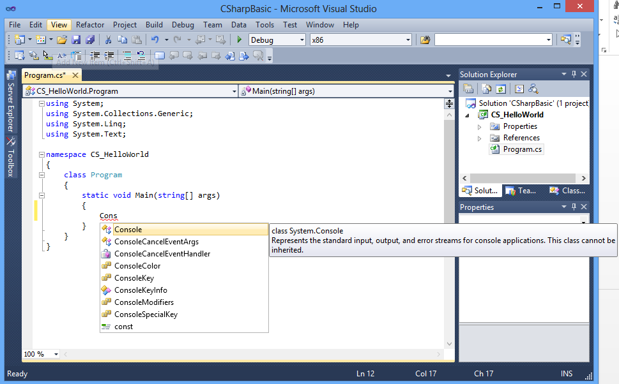
Write Code
Text Editor
Solution Explorer
Intellisense
Notes:
Start typing the code in a file.
Take help of Intellisense while writing code (do not code manually, select the appropriate type from the list. Helps you to write code faster and avoid spelling mistake)
Solution Explorer Window: Shows tree structure of organization of files and folders related to the application as part of the solution
Solution: Logical container of project(s). One or more than one project could be part of a single project. It is better to place multiple co-related applications in a single solution.

Slide 7
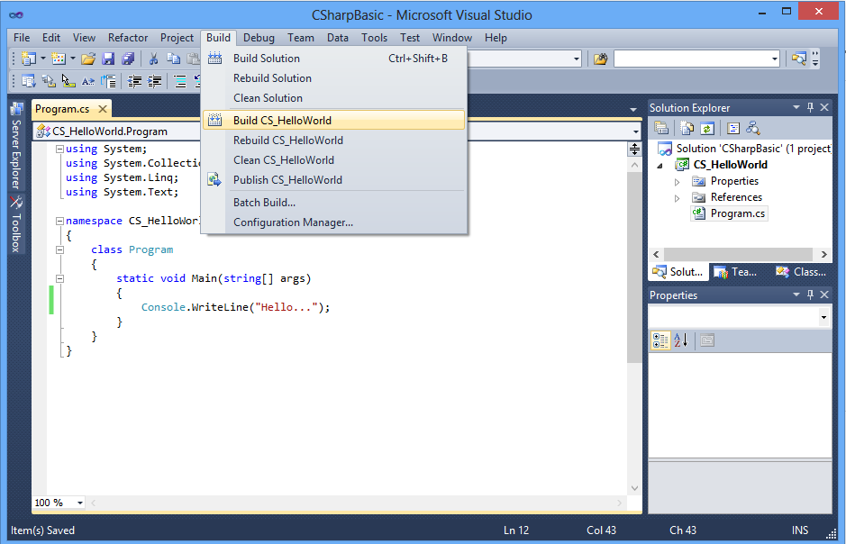
Compilation of the Application
Compilation switch
Notes:
Compilation:
You can choose build <project-name> or Build Solution. If you choose the former, then only one application (the current one) in the solution will be compiled. If you choose the later option, then all applications in the solution will be built.

Slide 8
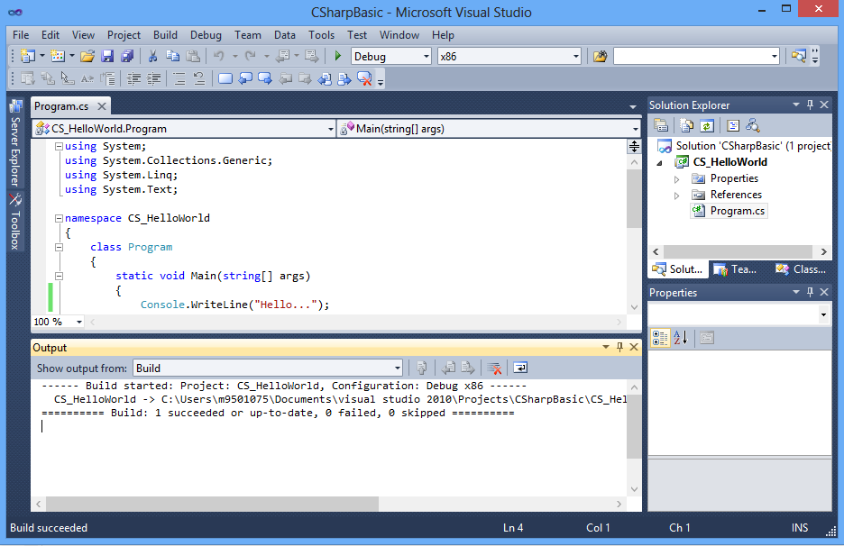
Compilation Output of the Application
Output Window
Notes:
Output Window: Displays the compilation status. (whether application has been successfully built or having errors or has been skipped as well as if there are multiple applications present in the same solution, then how many applications have been built or failed or skipped). Also, it displays the output file path (location of .exe or .dll file, created after compilation.

Slide 9
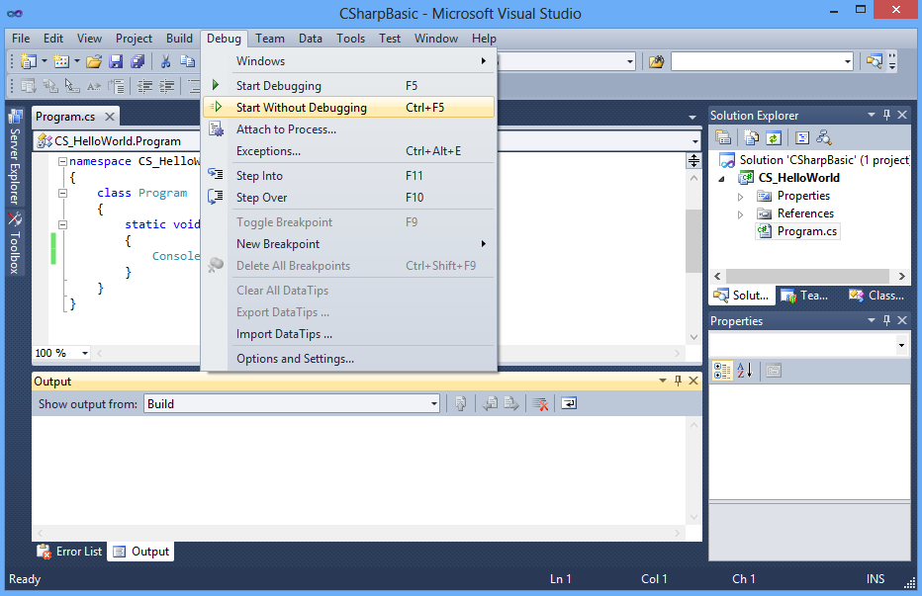
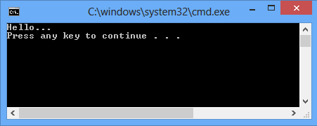
Run The Application
Run
Command Prompt showing output
Notes:
Run Options: If you choose Start Debugging (equivalent of pressing F5), then application will be debugged and output will be displayed in the Command Prompt (Console) and the Console will vanish even before you notice.
But, if you choose Start Without Debugging (equivalent of pressing Ctrl+F5), then the application will not be debugged and the console, displaying output, will be staying until and unless you hit any key.

Slide 10
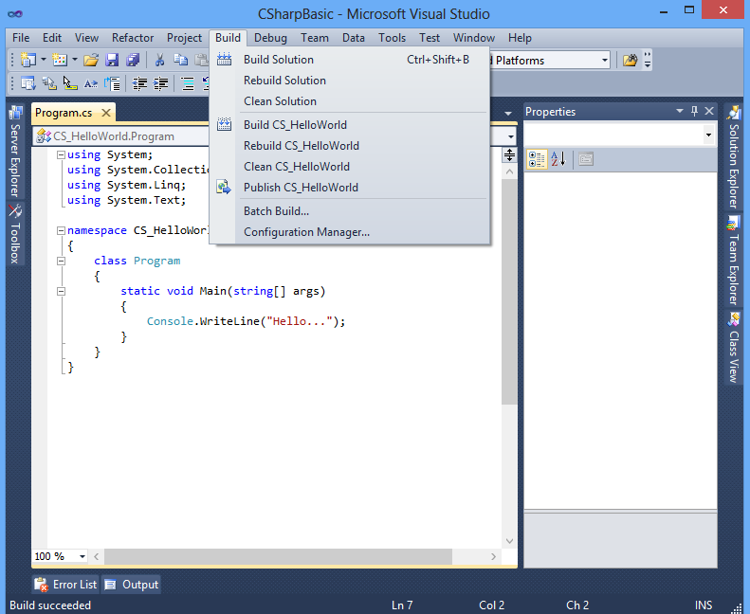
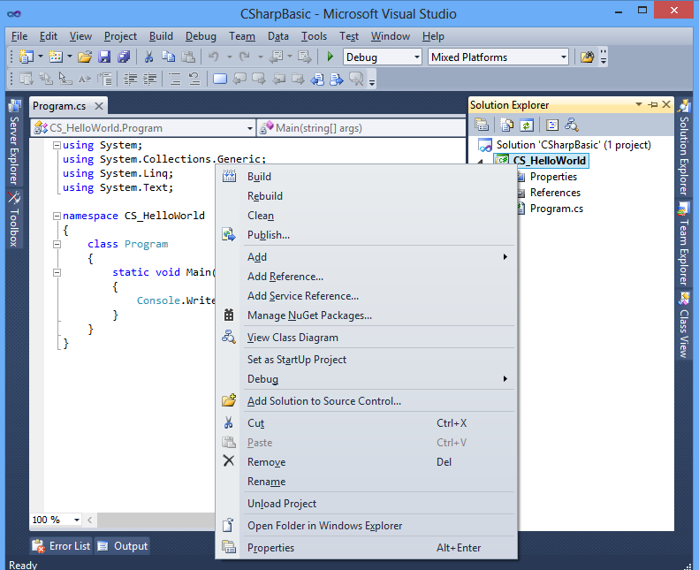
Rebuilding and Cleaning a Solution
Notes:
In Solution Explorer, choose or open the solution.
On the menu bar, choose Build, and then choose one of the following commands:
Choose Build or Build Solution to compile only those project files and components that have changed since the most recent build.
Choose Rebuild Solution to "clean" the solution and then build all project files and components.
Choose Clean Solution to delete any intermediate and output files. With only the project and component files left, new instances of the intermediate and output files can then be built.
To build or rebuild a single project
In Solution Explorer, choose or open the project.
On the menu bar, choose Build, and then choose either Build ProjectName or Rebuild ProjectName.
Choose Build ProjectName to build only those project components that have changed since the most recent build.
Choose Rebuild ProjectName to "clean" the project and then build the project files and all project components.
To build only the startup project and its dependencies:
On the menu bar, choose Tools, Options.
In the Options dialog box, expand the Projects and Solutions node, and then choose the Build and Run page.
The Build and Run, Projects and Solutions, Options dialog box opens.
Select the Only build startup projects and dependencies on Run check box.
When this check box is selected, only the current startup project and its dependencies are built when you perform either of the following steps:
On the menu bar, choose Debug, Start (F5).
On the menu bar, choose Build, Build Solution (CTRL+SHIFT+B).
When this check box is cleared, all projects, their dependencies, and the solution files are built when you run either of the preceding commands. By default, this check box is cleared.

Slide 11
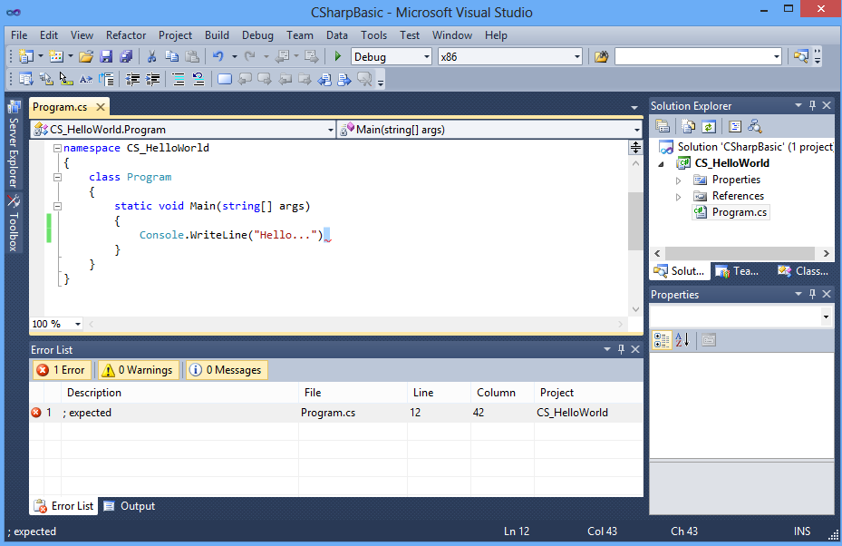
Finding Errors: Error List Window
Mistake in the code (forgot semi-colon)
Error list window displaying details of the error
Notes:
Error List Window: displays compilation errors (such as syntactical mistakes, invalid casting etc.). Double clicking on the line, displaying error details, in this window, will lead you to the line in code editor and you can then rectify the mistake.

Slide 12
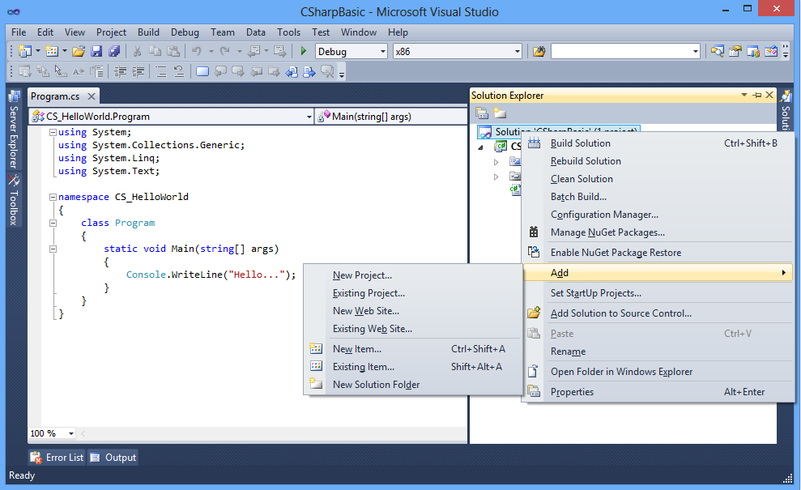
Adding Multiple Project in Same Solution
Notes:
Right click on the existing solution.
Choose Add>New Project and follow the steps same as that to create a new project (except that this time there is no need to enter Solution name)

Slide 13
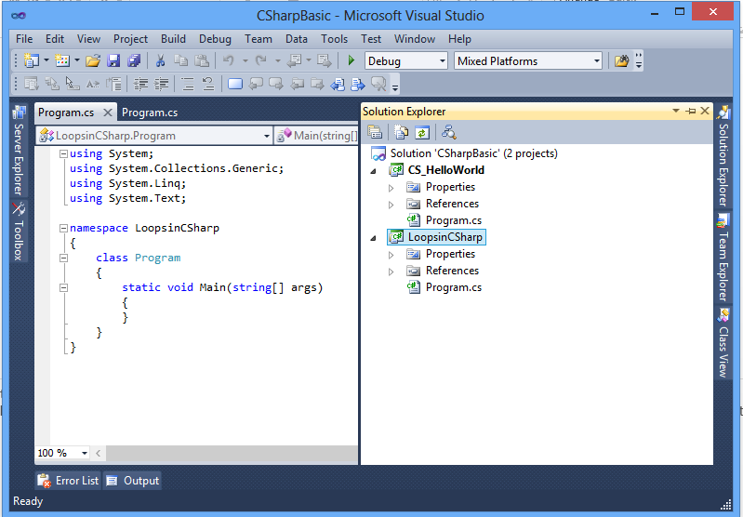
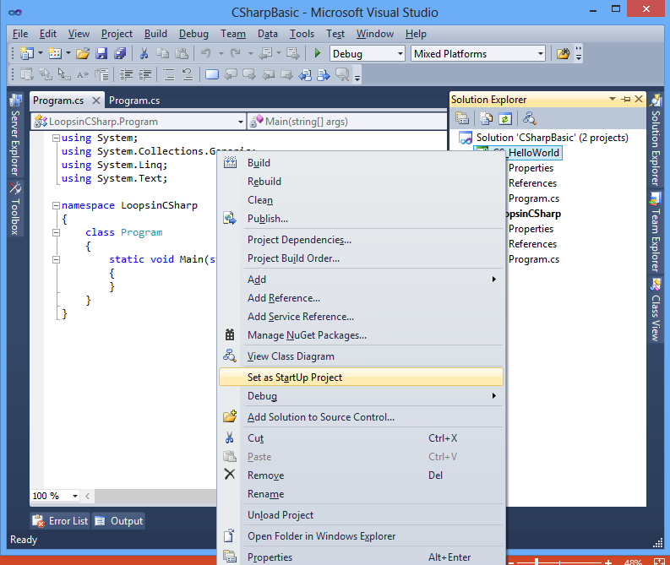
Set A Project as Start-up Project
Notes:
If you have multiple applications (projects) in the same solution and more than one are executable and you would like to run one of them or one of them is executable and you just would like run that application, the right click on that application and select Set as Start Up Project.

Slide 14
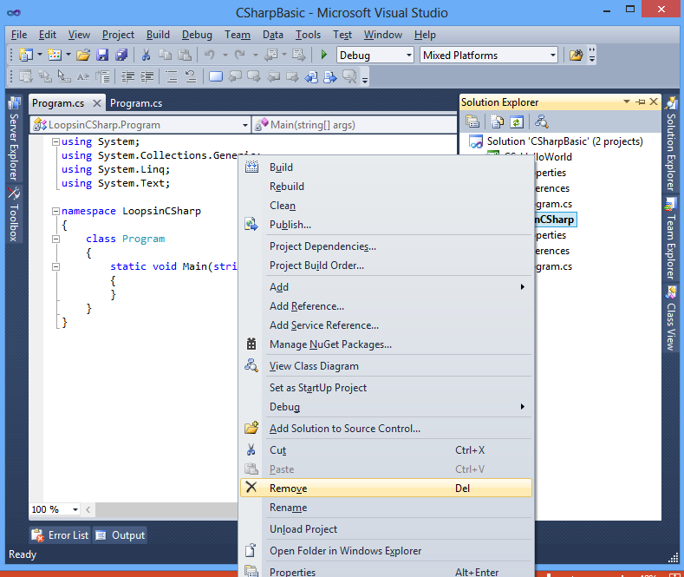
Remove an Existing Project
Notes:
To remove an existing project from a solution file, right click on the project in solution explorer window, then select Remove option

Slide 15
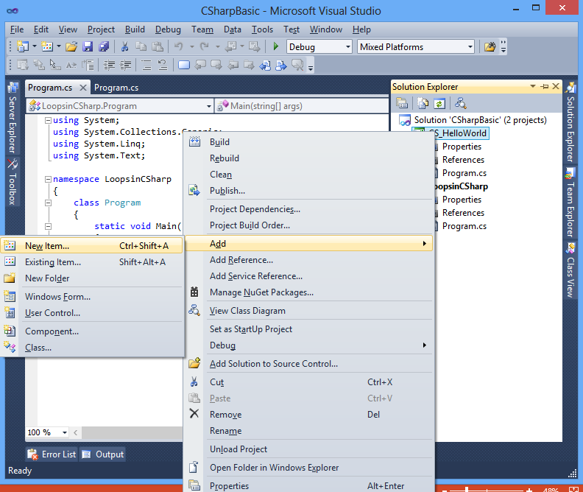
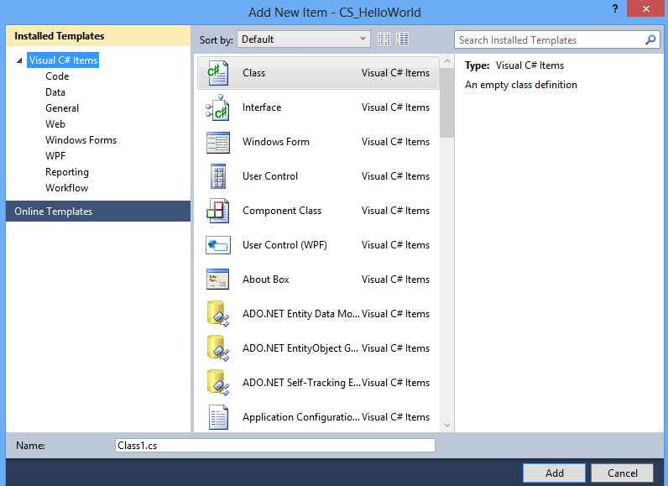
Adding New Item in an Existing Project
Notes:
If you want to add new item ( a class file etc.), then right click on the existing project name in the solution explorer and then choose Add>New Item
Add New Item dialog box will appear and then a select an item that you would lie to add in the project

Slide 16
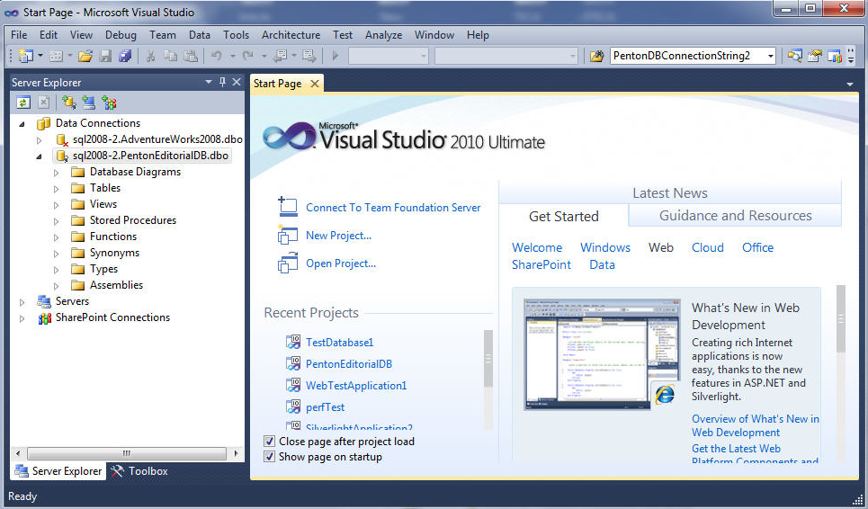
Server Explorer Window
Notes:
Server Explorer is the server management console for Visual Studio. Use this window to open data connections and to log on to servers and explore their databases and system services.
To access Server Explorer, choose Server Explorer on the View menu. To make the window close automatically when not in use, select Auto Hide on the Window menu.

Slide 17
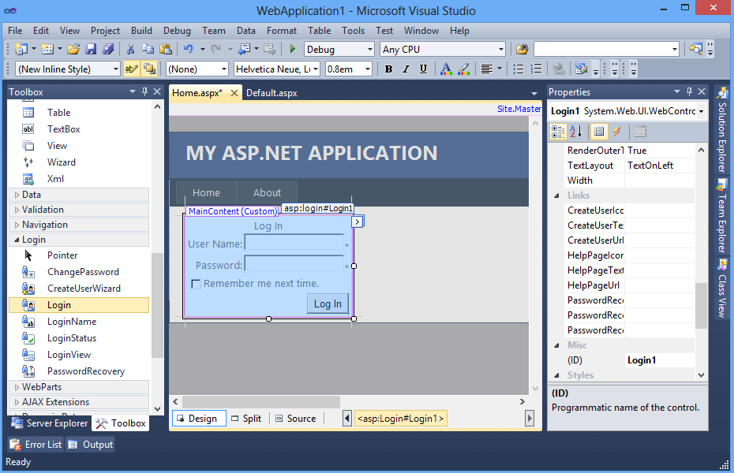
Properties Window and ToolBox Window
T
O
O
L
B
O
X
P
R
O
P
E
R
T
I
E
S
W
I
N
D
O
W
Notes:
Properties Window: Use this window to view and change the design-time properties and events of selected objects that are located in editors and designers. You can also use the Properties window to edit and view file, project, and solution properties. You can find Properties Window on the View menu. You can also open it by pressing F4 or by typing Properties in the Quick Launch window.
The Properties window displays different types of editing fields, depending on the needs of a particular property. These edit fields include edit boxes, drop-down lists, and links to custom editor dialog boxes. Properties shown in gray are read-only.
ToolBox: The Toolbox displays icons for controls and other items that you can add to Visual Studio projects. To open the Toolbox, click Toolbox on the View menu. You can dock the Toolbox, and you can pin it open or set it to Auto Hide.
Toolbox icons can be dragged to a design view or pasted in a code editor. Either action adds the fundamental code to create an instance of the Toolbox item in the active project file.
The Toolbox displays only the items that are appropriate to the type of file you are working in. You can search within the Toolbox to further filter the items that appear. If your project requires a control that is not supported by the Client Profile, you can set your project to target the entire framework by editing the project properties.

Slide 18
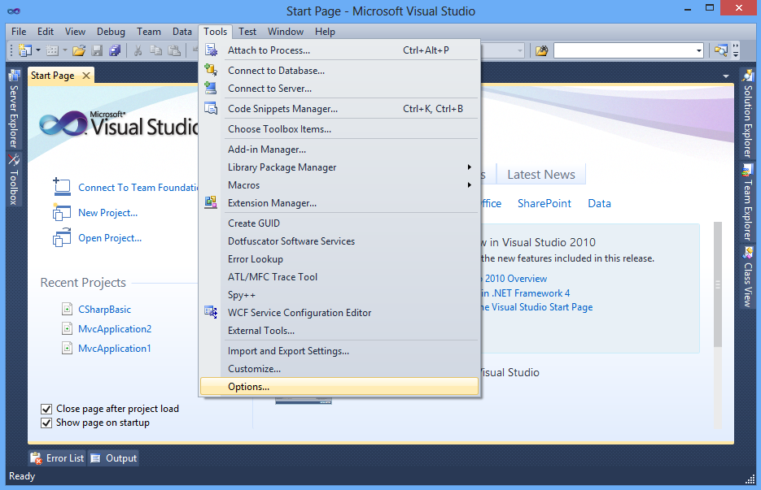
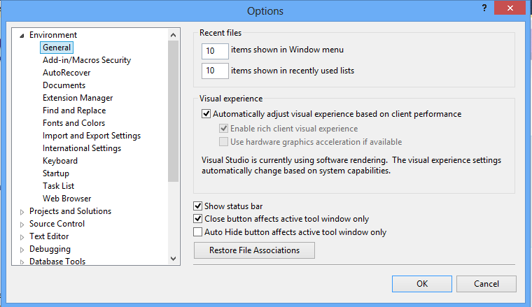
Setting Changes in Visual Studio
Notes:
Select Options from Tools menu
It will open Options dialog box

Slide 19
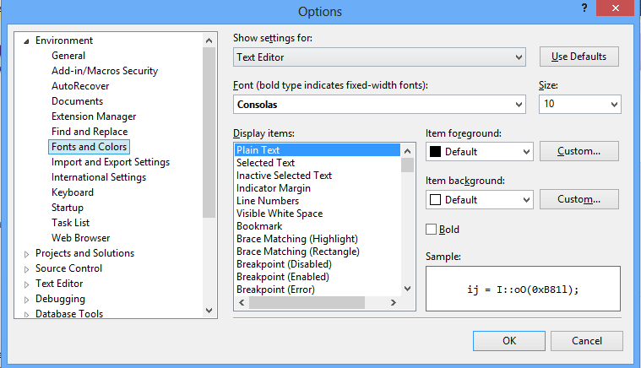
Change Font Settings
Notes:
To change Font setting, select Fonts and Colors and select proper font family, font size etc. from panel on the right side.

Slide 20
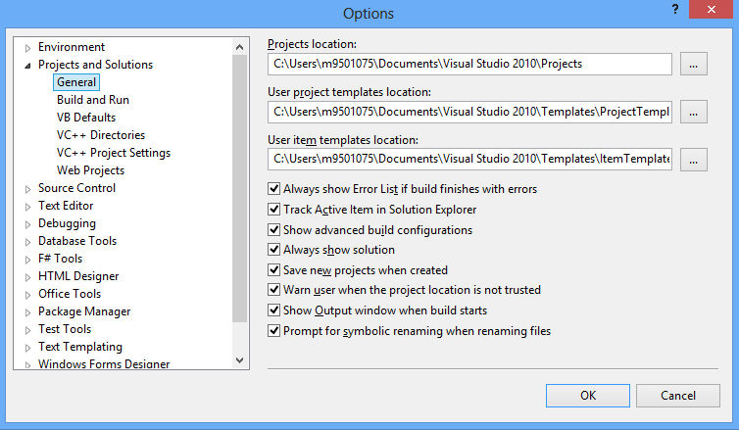
Change Projects and Solutions Settings
Notes:
Then hide Environment setting and click on Projects and Solutions and select General under that. Check every check box is checked on the right side panel or not

Slide 21
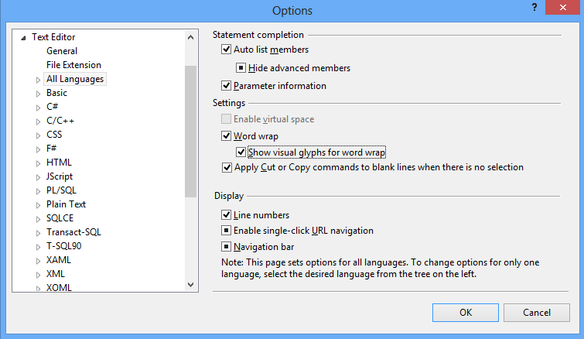
Change Text Editor Settings
Notes:
Now select Text Editor and then select All Languages. Check the check boxes for Word Wrap, Show Visual Glyphs for word wrap, Line numbers and anything else that require.

Slide 22
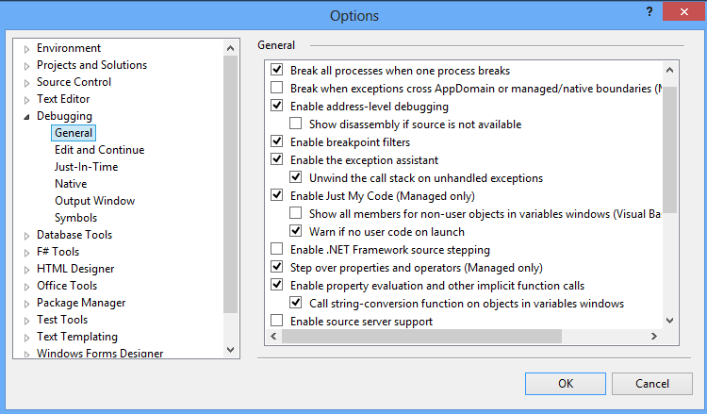
Change Debugging Setting
Uncheck the check box
Notes:
Select Debugging, and the select General under that. On the right side panel, uncheck the check box for Step over properties and operators (Managed only), so that enable property and operator debugging

Slide 23
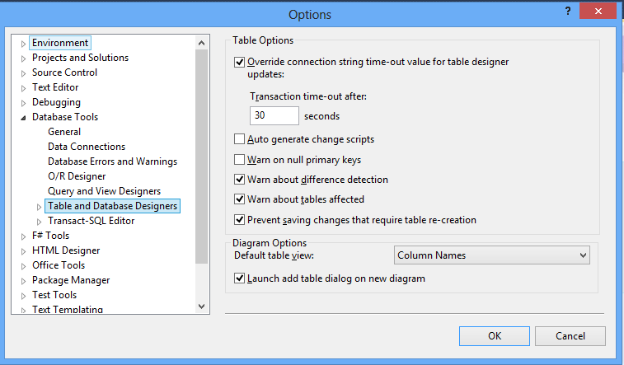
Change Database Tools Settings
Uncheck the check box
Notes:
Select Database Tools and expand it. Select Table and Database Designers. Then Uncheck the check box for Prevent Saving changes that require table re-creation. This way, while altering database table through Server Explorer Window, you will not require drop and re-create table, rather direct modification will be possible.

Slide 24
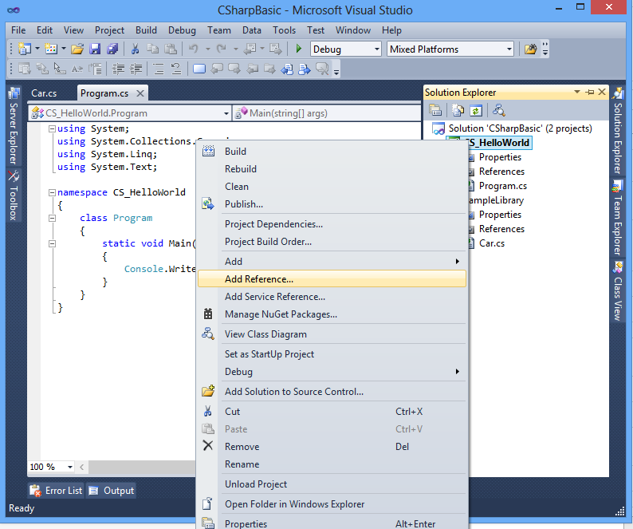
Adding Reference
Notes:
Right click on the existing application in solution explorer and then select Add Reference.

Slide 25
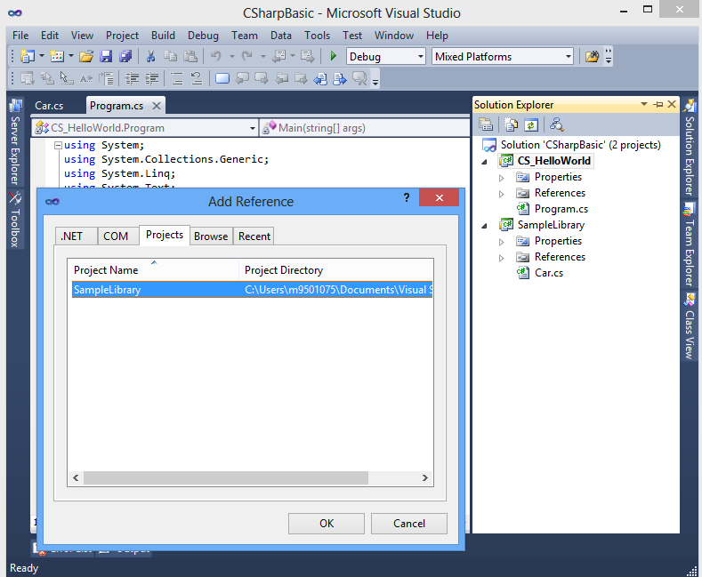
Adding Reference to a library application present in same solution
Notes:
Click on Projects tab if you would like to add reference to an existing library application, present in the same solution

Slide 26
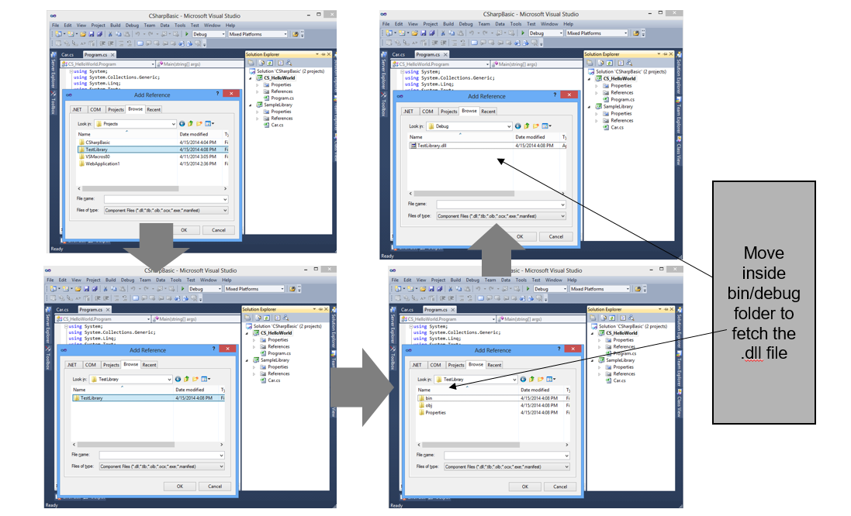
Adding Reference to a Library Application Which is Part of Other Solution (not in same solution)
Notes:
Click on Browse tab if you would like to add reference to an existing library application, present in the different solution.
Browse through application directory and move inside bin/debug directory.
Select the .dll file present in that and click on OK button.

Slide 27
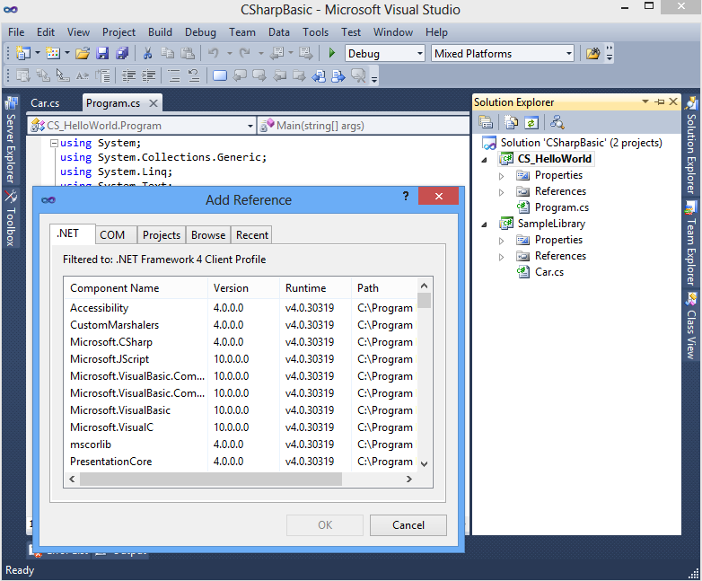
Add Reference to any .NET base class library
Notes:
Click on .NET tab in order the get the list of libraries part of .NET base class library and select the appropriate one and then click on OK button

Slide 28
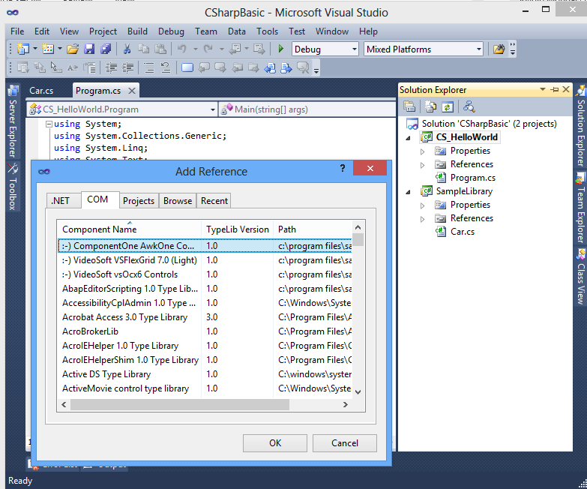
Add Reference to any COM library
Notes:
Click on COM tab in order the get the list of libraries part of COM technology and select the appropriate one and then click on OK button

Slide 29
Reference
http://msdn.microsoft.com/en-us/library
For Build, Rebuild and Clean options, visit this link
http://msdn.microsoft.com/en-us/library/5tdasz7h.aspx
Refer the following books
CLR via C#
Pro C# 2008 and the .NET 3.5 platform by Andrew Troelsen
Visual C# Step by Step
Notes:
Reference

